Slide 1
Python Pizza Course 2019
Part #3: Data handling by Maarten Pronk & Martijn Visser

Slide 2

Introduction
Meant as follow up from part #1 and #2
You have a Anaconda Python 3.7 installation working + Jupyter notebook
Data handling in Python
Reproducability, README, requirements, anaconda
NumPy, Pandas, xarray, rasterio libraries
Data handling
CSV, NetCDF, GeoTIFF file formats
Split, apply, combine strategy
Above applied in practical examples
Introduction round
You can find the Jupyter notebooks in my Postbox (Pronk, Maarten)

Slide 3
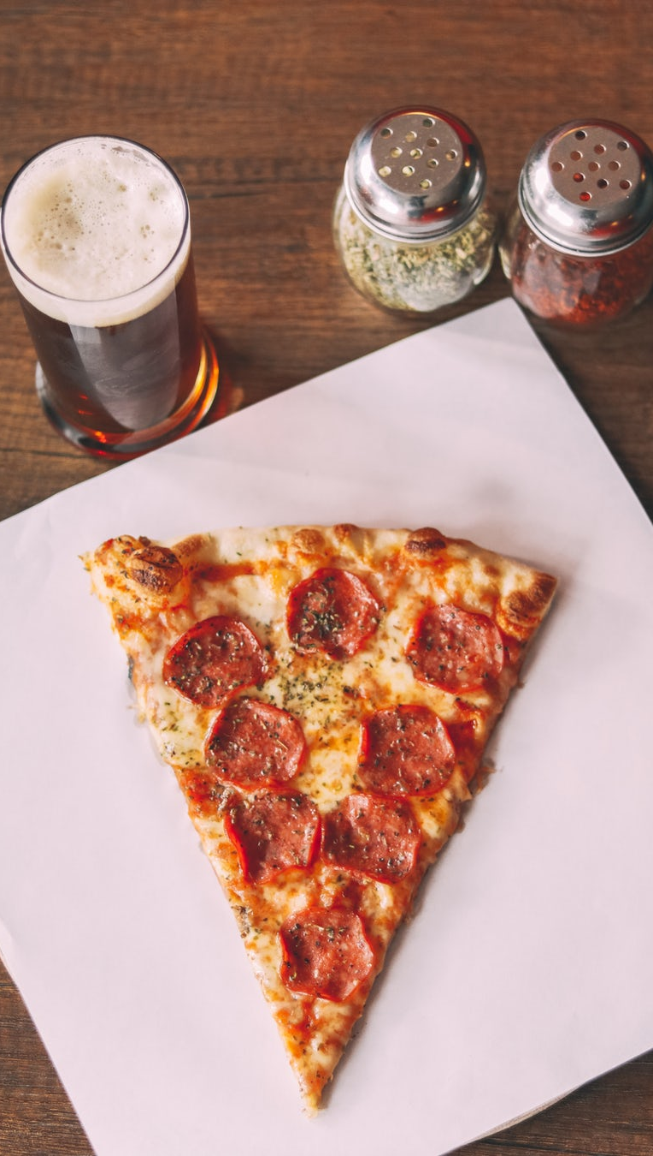
Schedule
1 hour + 15m questions
Repro (also installation)
NumPy arrays 2D etc
CSV (raw)
Pandas CSV
Pizza!
1 hour + 15m questions
Pandas split apply combine
xarray NetCDF (+raw struct)
GeoTIFFs

Slide 4

Questions?

